Slide 1
IPL 2025 Batting Performance Analysis
Presented by : Siddhesh Pitale
College : Yeshwantrao Chavan College of Engineering, Nagpur
Branch : Computer Technology
Company Name : Alexler

Slide 2
Introduction
Objective:
To analyze player batting performance from the IPL 2025 season using Excel-based data modeling and visualization.
Tools and Techniques:
Microsoft Excel with advanced data features (Pivot tables, Charts, Slicers).
Data Source:
Batting performance dataset from IPL 2025 season.

Slide 3

Problem Statement
Teams and analysis need meaningful insights from player statistics.
Raw stats do not immediately reveals performance trends.
Goal: Summarize batting performance and identify top contributors, trends and correlation.

Slide 4

Methodology
1) Pivot Tables:-
i) Total runs by team and players.
ii) Average and strike rate comparison
iii) High score distribution
iv) Boundaries analysis (4s & 6s)
2) Charts Used:-
Bar, Column, Line and Scatter plot
3) Interactivity:-
Slicers added for filtering by team, player,etc

Slide 5
Raw Data

Slide 6

Report

Slide 7
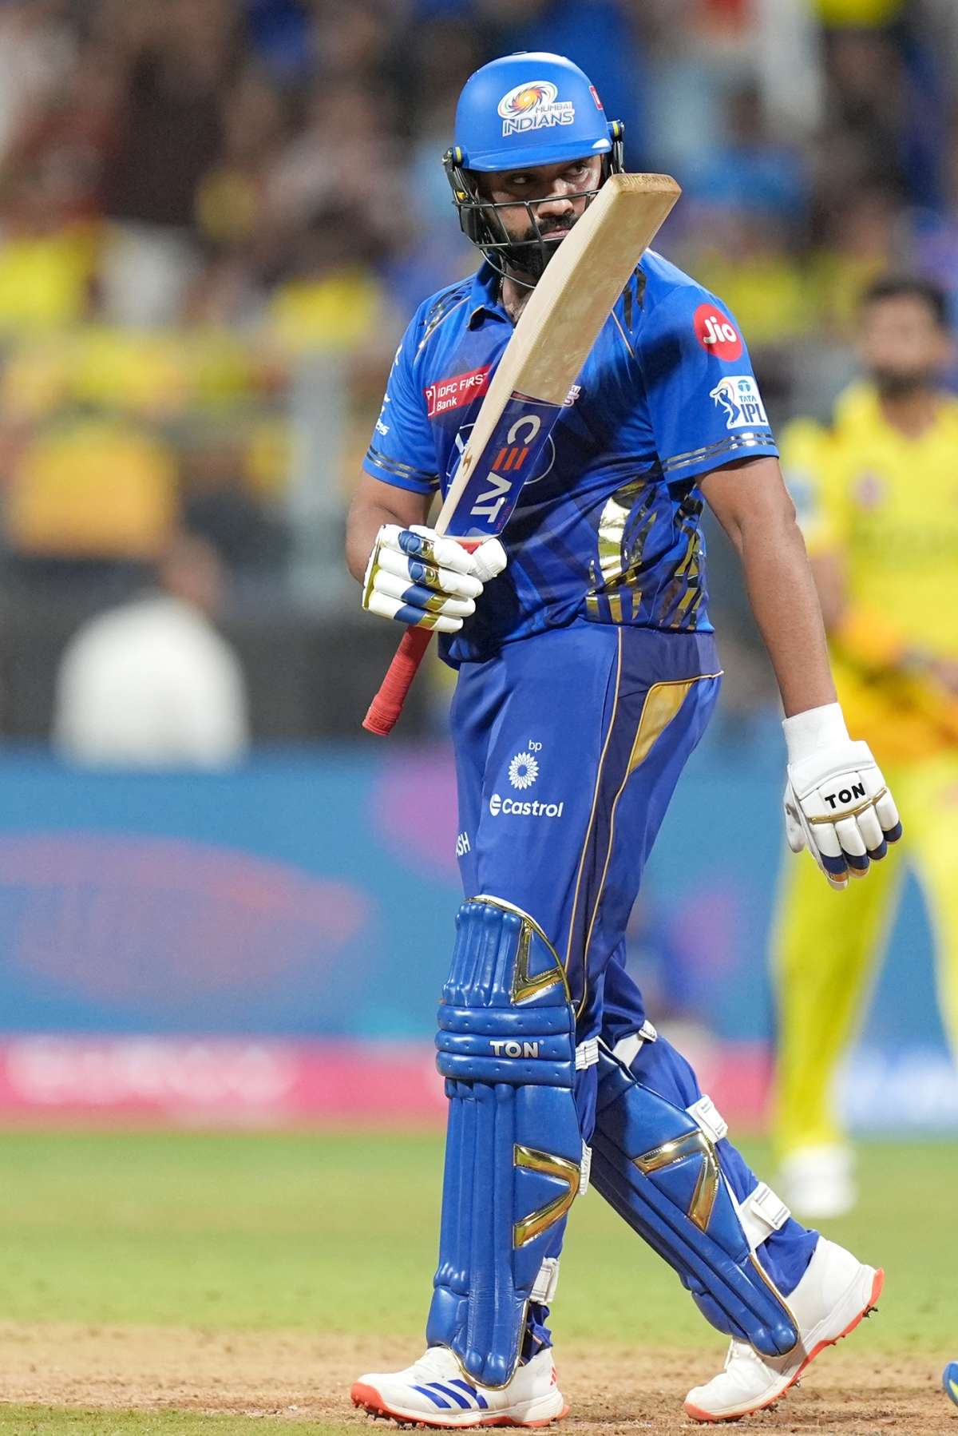
Total matches & Runs scored by each Player of Each Team
.

Slide 8
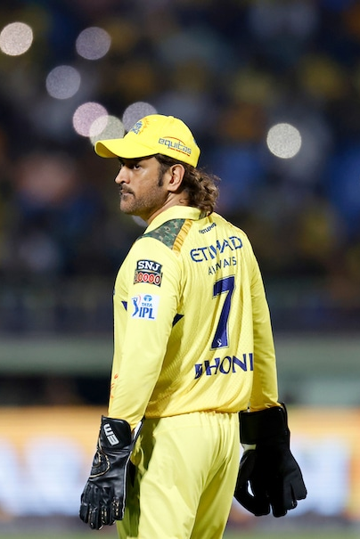
Total 4s & 6s by Each players of Each team

Slide 9
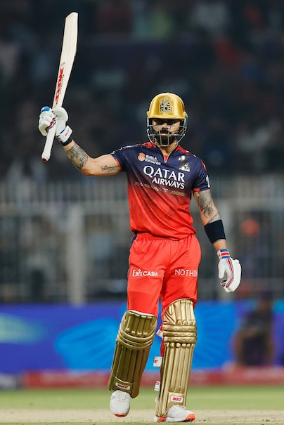
Average and avg Strike rate by each player of each team

Slide 10
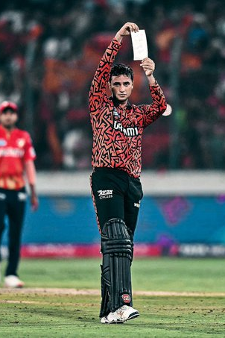
No. of 100s & 50s by every team

Slide 11
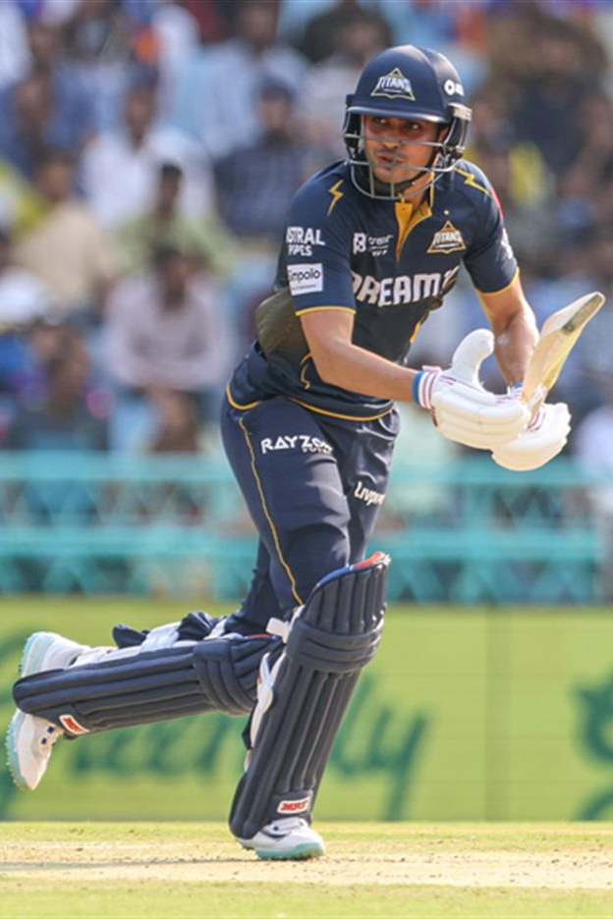
Total Matches and total runs scored by each players

Slide 12
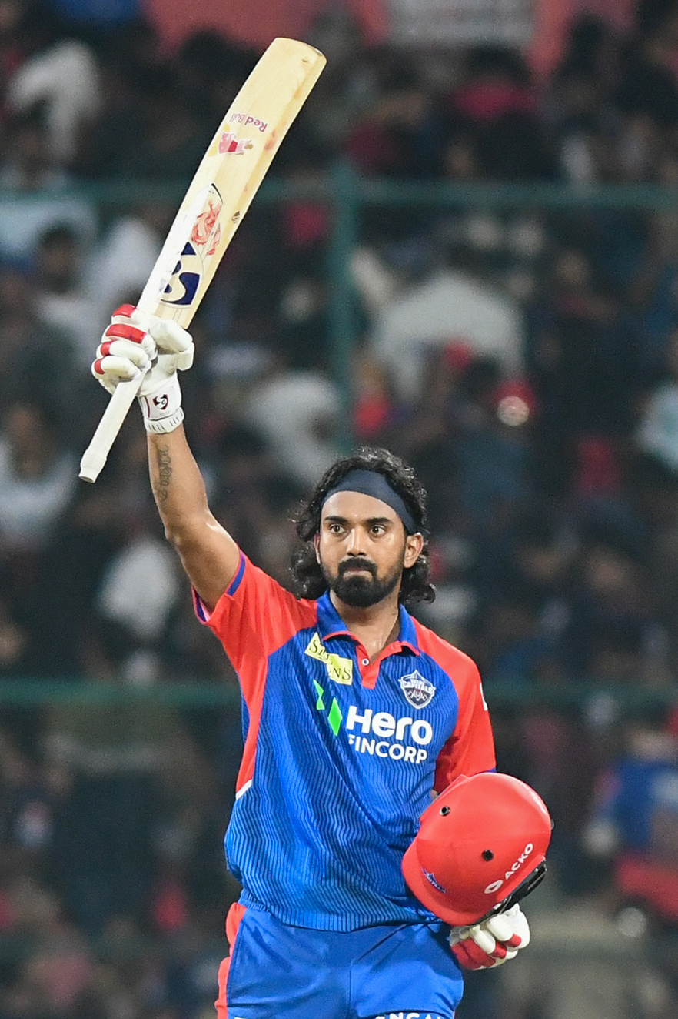
Highest Runs scored by each Players of each team

Slide 13

cONCLUSION
.

Slide 14

.
Visualization helped uncover key batting insights from IPL 2025,
Pivot tables and charts made performance trends clear and interactive.
Slicers enabled quick filtering by teams and players.
Overall, Excel proved effective for analyzing large cricket datasets.

Slide 15
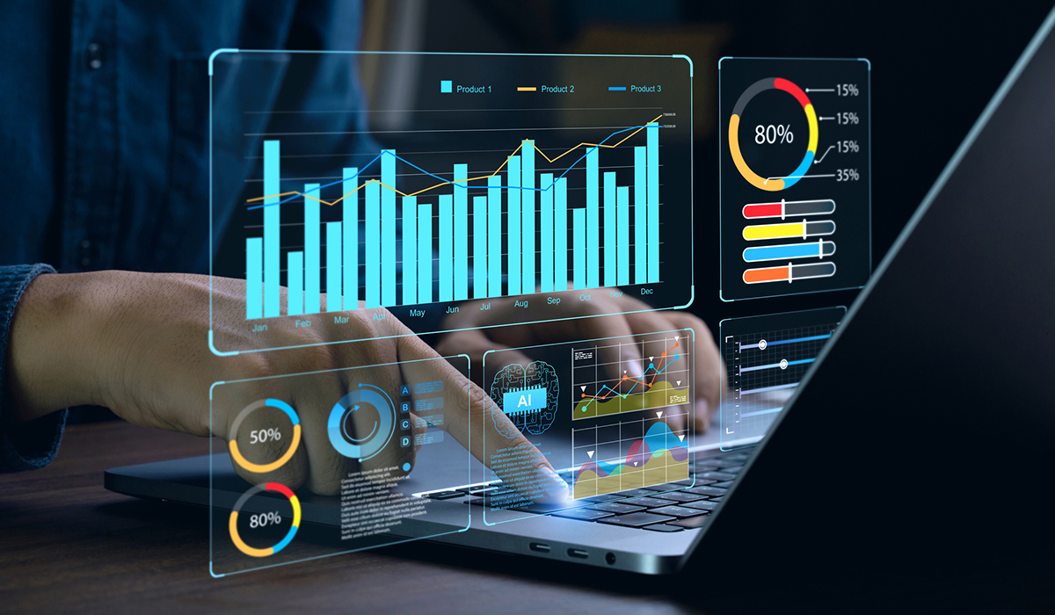
Future scope
AI & ML Integration : Predictive & prescriptive analytics.
Big Data & Cloud : Scalable data Processing.
IoT & Edge Analytics : Real time data processing.
Quantum Computing : Future potential for complex analytics.
Industry Applications :
Healthcare: Personalized Medicine.
Finance : Fraud Detection, risk management

Slide 16
Thank You !!!

